Slide 1
Normalisation of Database Tables
Week 4
Dr. Farshid Keivanian

Slide 2
Week 4 Outline
Normalisation: What, Why, How
1NF (no repeating groups, atomic values, PK identified)
2NF (remove partial dependency on part of composite PK)
3NF (remove transitive dependency)
Higher normal forms (BCNF & 4NF)
Denormalisation (when & why)
Keys & Surrogate Keys
Checklist & Wrap
Tutorial Week 4
Submission of Tutorials & Assessments
Review and Feedback on Tutorial Week 3

Slide 3
Normalisation: What, Why, How
What:
A step-by-step way to clean and organise tables so data isn’t messy or duplicated.
Why:
Keeps data accurate and consistent (no contradictions).
Makes updates easier (change once, not in many places).
Queries run smoother and are easier to understand.

Slide 4
Normalisation: What, Why, How
How:
Start with 1NF → remove repeating groups, make values atomic.
Move to 2NF → remove partial dependency.
Then 3NF → remove transitive dependency.
Go higher (BCNF/4NF) only if needed. Break rules only if performance requires it (that’s denormalisation).

Slide 5
1NF (no repeating groups, atomic values, PK identified)
Rules:
Every column = one single value (atomic).
No lists or repeating groups in one cell.
Must have a primary key to uniquely identify rows.

Slide 6
1NF (no repeating groups, atomic values, PK identified)
Analogy (AUS):
Imagine a Myki trip record in Melbourne. Bad: one cell says “Stations: Richmond, Flinders, Parliament” (list inside one cell). Good: each trip is one row → Richmond in one row, Flinders in another, Parliament in another.

Slide 7

1NF (no repeating groups, atomic values, PK identified)
Quick Problem (5 min) Q: The table has:
TripID | Passenger | Stations
1 | Sarah | Richmond, Flinders, CBD
1. What’s wrong here? 2. How would you fix it to make it 1NF?

Slide 8
1NF (no repeating groups, atomic values, PK identified)
Quick Problem (5 min) Q: The table has:
TripID | Passenger | Stations
1 | Sarah | Richmond, Flinders, CBD
The Stations column contains multiple values inside one cell → violates 1NF.

Slide 9
1NF (no repeating groups, atomic values, PK identified)
A (after 5 min): Split into separate rows:
TripID | Passenger | Station
1 | Sarah | Richmond
1 | Sarah | Flinders
1 | Sarah | CBD
When we move from the unnormalized form (UNF) to 1NF, we do create more rows (and that looks like duplicates). But this is exactly the goal of 1NF — each row must represent a single fact, and columns must be atomic (no lists).

Slide 10
1NF (no repeating groups, atomic values, PK identified)
A (after 5 min): Split into separate rows:
TripID | Passenger | Station
1 | Sarah | Richmond
1 | Sarah | Flinders
1 | Sarah | CBD
Now, each row = one trip + one station only. The "duplicates" we see are not duplicates — they are valid multiple facts about Sarah’s trip.

Slide 11
1NF (no repeating groups, atomic values, PK identified)
TripID | Passenger | Station
1 | Sarah | Richmond
1 | Sarah | Flinders
1 | Sarah | CBD
Key point to explain to students
UNF → 1NF often increases the number of rows.
It’s not “duplicate data,” it’s decomposed data (atomic facts).
Later, 2NF and 3NF will further reduce redundancy by splitting into separate tables (e.g., a Passenger table and a TripStation table).

Slide 12
2NF (remove partial dependency on part of composite PK)
What: Table must already be in 1NF.
Every non-key attribute must depend on the whole composite key, not just part of it.
If some attributes only depend on one part, move them to a separate table

Slide 13
2NF (remove partial dependency on part of composite PK)
Analogy: Your street name depends on your house number, not on your seat number in a classroom. So don’t tie unrelated facts together in the same table.

Slide 14
2NF (remove partial dependency on part of composite PK)
Example: Applying 2NF - From our current 1NF table:
TripID | Passenger | Station
1 | Sarah | Richmond
1 | Sarah | Flinders
1 | Sarah | CBD
Composite PK here is: (TripID, Station).
Now check dependencies:
Station depends on both TripID + Station (OK).
Passenger depends only on TripID (not on Station). Partial dependency.

Slide 15
2NF (remove partial dependency on part of composite PK)
To fix this, split into two tables:
What Happened?
Passenger now depends only on TripID → moved to TRIP.
Stations remain tied to TripID in TRIP_STATION.
No partial dependency left.
TripID | Passenger
1 | Sarah
TripID | Station
1 | Richmond
1 | Flinders
1 | CBD

Slide 16
2NF (remove partial dependency on part of composite PK)
Quick Problem (5 min for class)
OrderID | CustomerName | Product
1 | Alice | Phone
2 | Alice | Charger
3 | Bob | Tablet
What’s the partial dependency? How would you split it into 2NF?

Slide 17
2NF (remove partial dependency on part of composite PK)
OrderID | CustomerName | Product
1 | Alice | Phone
2 | Alice | Charger
3 | Bob | Tablet
What’s the partial dependency?
The composite PK here is (OrderID, Product).
CustomerName depends only on OrderID, not on the full PK (OrderID + Product).
That means we have a partial dependency → violation of 2NF.

Slide 18
2NF (remove partial dependency on part of composite PK)
Now:
CustomerName depends only on OrderID (fixed).
Product depends on OrderID + Product (still correct).
No partial dependency remains → table is in 2NF.
How to split into 2NF?
ORDER table
OrderID | CustomerName
1 | Alice
2 | Bob
ORDER_PRODUCT table
OrderID | Product
1 | Phone
1 | Charger
2 | Tablet

Slide 19
2NF (remove partial dependency on part of composite PK)
How to split into 2NF?
ORDER table
It’s like storing Alice’s name again and again for every product Alice buys. In 2NF, we just list her name once in the ORDER table, and her products separately.
OrderID | CustomerName
1 | Alice
2 | Bob
ORDER_PRODUCT table
OrderID | Product
1 | Phone
1 | Charger
2 | Tablet

Slide 20
3NF (remove transitive dependency)
Rules:
Must already be in 2NF.
No non-key attribute should depend on another non-key attribute.
In other words: every non-key attribute must depend only on the primary key.

Slide 21
3NF (remove transitive dependency)
Example
If our EMPLOYEE table looks like this:
EmpID | EmpName | JobClass | HourlyRate
1 | Alice | DBA | $95
2 | Ben | Analyst | $65
Problem: HourlyRate depends on JobClass, not directly on EmpID. That’s a transitive dependency → violates 3NF.
Fix: Split into two tables

Slide 22
3NF (remove transitive dependency)
EMPLOYEE
EmpID | EmpName | JobClass
1 | Alice | DBA
2 | Ben | Analyst
JOB
JobClass | HourlyRate
DBA | $95
Analyst | $65

Slide 23
3NF (remove transitive dependency)
Analogy
Think of a coffee order:
Customer record should store what size coffee they bought.
But the price of “Large” should not be in the customer’s record → it belongs in the Coffee Size table.

Slide 24
3NF (remove transitive dependency)
Question 5-min Problem for Students
CarID | CarModel | Manufacturer | ManufactureCity
1 | Corolla | Toyota | Sydney
2 | Camry | Toyota | Sydney
3 | CX-5 | Mazda | Melbourne
What’s the transitive dependency? How would you split into 3NF?

Slide 25
3NF (remove transitive dependency)
Answer (after 5 min):
ManufacturerCity depends on Manufacturer, not on CarID.
Split into:
CAR
MANUFACTURER
CarID | CarModel | Manufacturer
1 | Corolla | Toyota
2 | Camry | Toyota
3 | CX-5 | Mazda
Manufacturer | ManufacturerCity
Toyota | Sydney
Mazda | Melbourne

Slide 26
Higher normal forms (BCNF & 4NF)
Boyce–Codd Normal Form (BCNF)
Extension of 3NF.
Rule: Every determinant must be a candidate key.
Usually only needed in edge cases where 3NF still leaves anomalies.
Example: A room can only have one course, and each course has only one teacher → can create anomalies unless restructured. We’ll only touch this conceptually.

Slide 27
Higher normal forms (BCNF & 4NF)
Fourth Normal Form (4NF)
Removes multi-valued dependencies.
Problem: one table contains two independent lists, and combining them creates wrong “spurious” rows.
Example:
We don’t mean Alice plays every instrument with every sport — but the table forces that combination.
Fix: Split into two independent tables.
Student | Sport | Instrument
Alice | Soccer | Piano
Alice | Soccer | Guitar
Alice | Tennis | Piano
Alice | Tennis | Guitar

Slide 28
Higher normal forms (BCNF & 4NF)
STUDENT_SPORT
Student | Sport
Alice | Soccer
Alice | Tennis
Student | Sport | Instrument
Alice | Soccer | Piano
Alice | Soccer | Guitar
Alice | Tennis | Piano
Alice | Tennis | Guitar
STUDENT_INSTRUMENT
Student | Instrument
Alice | Piano
Alice | Guitar

Slide 29
Higher normal forms (BCNF & 4NF)
Analogy (Australia context)
Think of a Myki cardholder:
A passenger can have many train lines they travel on and many discounts they qualify for.
If we keep both lists in one table, it wrongly suggests every train line is linked to every discount.
Better: keep Passenger–TrainLine separate from Passenger–Discount.

Slide 30
Higher normal forms (BCNF & 4NF)
Quick 5-min Problem for Students Q: This table shows:
Teacher | Language | Sport
Lee | English | Football
Lee | English | Cricket
Lee | French | Football
Lee | French | Cricket
What’s the issue? How would you fix it?

Slide 31
Higher normal forms (BCNF & 4NF)
Teacher | Language | Sport
Lee | English | Football
Lee | English | Cricket
Lee | French | Football
Lee | French | Cricket
Before 4NF: One table stores both Sports and Instruments for Alice. → This creates spurious combinations (implies Alice plays Piano while playing Soccer, which isn’t true).

Slide 32
Higher normal forms (BCNF & 4NF)
Teacher_Language
Teacher_Sport
Teacher | Language
Lee | English
Lee | French
Teacher | Sport
Lee | Football
Lee | Cricket
Languages and sports are independent lists. Keeping them in one table falsely creates every Language × Sport combination. Splitting removes those spurious rows.
After (4NF split into two tables)
Keep Student–Sport in one table.
Keep Student–Instrument in another. → No fake combinations; each fact is recorded once and correctly.

Slide 33
Denormalisation (when & why)
What it means
We break the rules of normalisation on purpose.
We store a derived or repeated value to make queries run faster.
Why we do it
Sometimes reading/joining from many tables is too slow.
Denormalisation makes reading simpler and faster.

Slide 34
Denormalisation (when & why)
Trade-off
More redundancy → same data stored in multiple places.
Updates are costlier: if one value changes, we must update it in several places.
Higher risk of inconsistency (values don’t match).

Slide 35
Denormalisation (when & why)
Example (Australia)
In a university system, instead of always recalculating GPA from every subject’s marks, we store a “Current GPA” column in the student table.
Faster to display transcripts.
But if subject marks change and GPA isn’t updated everywhere → inconsistency.

Slide 36
Denormalisation (when & why)
Safety Tip
Only denormalise when:
There is a clear performance need, and
You guard correctness with constraints, triggers, or stored procedures.

Slide 37
Denormalisation (when & why)
Quick 5-min Problem for Class Q: You have this normalised setup:
ORDER (OrderID, CustomerID, Date)
CUSTOMER (CustomerID, Name, Address)
To speed up reporting, someone adds CustomerName directly into ORDER.
What’s the advantage?
What’s the risk?

Slide 38
Denormalisation (when & why)
Answer (after 5 min):
Advantage: Faster to display order + customer info (no join needed).
Risk: If customer changes name/address → mismatch between ORDER and CUSTOMER tables.

Slide 39
Keys & Surrogate Keys
Natural Key
Comes from real-world data (e.g., Tax File Number, Passport Number, Student Email).
Problem: These can change (name/email updates, passport expiry).
Surrogate Key
A system-generated key (usually an INTEGER with auto-increment).
Has no meaning outside the database.
Stable: won’t change even if other values change.

Slide 40
Keys & Surrogate Keys
Analogy (Australia context)
Think of a Medicare record:
Your Medicare number (real-world) could change if the government re-issues cards → not stable.
But in the hospital’s database, you also get an internal PatientID (surrogate key).
The PatientID never changes, even if your address, phone, or Medicare number changes.

Slide 41
Keys & Surrogate Keys
Quick 5-min Problem for Students
Q: You are designing a database for university students. Should you use StudentEmail or an auto-generated StudentID as the PK? Why?
Answer (after 5 min):
StudentEmail: can change (students graduate, change providers).
StudentID: stable, system-generated, and unique → best choice.

Slide 42
Checklist & Wrap
Use surrogate keys for stability.
Ensure all entities are in 3NF or higher (unless denormalisation is justified).
Check PKs are unique & non-intelligent.
Verify FKs match PKs (referential integrity).
Relationships are clearly labelled (1:1, 1:M, M:N).
All business rules are reflected.

Slide 43
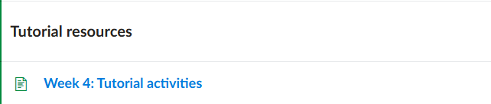
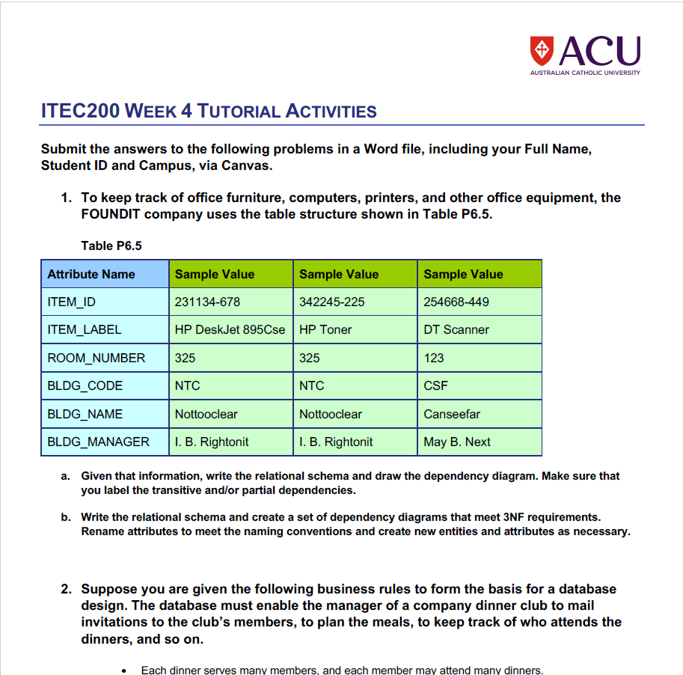
Tutorial Week 4
One big table that mixes item details and building details.
Key identifiers
PK: ITEM_ID (uniquely identifies each item)

Slide 44
Tutorial Week 4
Primary key: ITEM_ID
Functional dependencies (FDs)
ITEM_ID → ITEM_DESCRIPTION, ROOM_NUMBER, BLDG_CODE
BLDG_CODE → BLDG_NAME, BLDG_MANAGER
arrow legend: A → B means “A determines B.”

Slide 45
Tutorial Week 4
Functional dependencies:
Knowing an item (ITEM_ID) tells you its description, room, and building code.
Knowing a building (BLDG_CODE) tells you its name and manager.
a) Initial relational schema & dependencies
Raw (unnormalised) table
ITEM( ITEM_ID, ITEM_DESCRIPTION, ROOM_NUMBER, BLDG_CODE, BLDG_NAME, BLDG_MANAGER )

Slide 46
Tutorial Week 4
Why it’s a problem
Building name/manager will repeat for every item in that building → risk of update/insert/delete anomalies.

Slide 47
Tutorial Week 4
What the arrows mean
Solid arrow A → B = “A determines B.”
Dotted chain = transitive link (e.g., ITEM_ID → BLDG_CODE → BLDG_NAME).

Slide 48
Tutorial Week 4
This is the starting point before normalization; next we’ll split building/employee info out to remove the transitive dependency.

Slide 49
Tutorial Week 4
Transitive dependency
ITEM_ID → BLDG_CODE → (BLDG_NAME, BLDG_MANAGER) ← (this causes redundancy)
(Optional/arguable: if room numbers embed the building, you might also have ROOM_NUMBER → BLDG_CODE, BLDG_NAME, but we won’t rely on that.)
Definition: Transitive dependency = A→B and B→C ⇒ A→C where C is non-key.
Determinant note: BLDG_CODE is the determinant of (BLDG_NAME, BLDG_MANAGER/EMP_NUM).
Location key tip: treat (BLDG_CODE, ROOM_NUMBER) as a candidate key for room uniqueness.

Slide 50
Dependency Diagram:
ITEM_ID ─────────► ITEM_DESCRIPTION
└──────────► ROOM_NUMBER
└──────────► BLDG_CODE ─────────► BLDG_NAME
└───► BLDG_MANAGER
(transitive: ITEM_ID → BLDG_CODE → BLDG_NAME, BLDG_MANAGER)
Legend: A → B = A determines B; underlined = primary key; brown = FD, dotted = transitive.

Slide 51
Dependency Diagram:
ITEM_ID ─────────► ITEM_DESCRIPTION
└──────────► ROOM_NUMBER
└──────────► BLDG_CODE ─────────► BLDG_NAME
└───► BLDG_MANAGER
(transitive: ITEM_ID → BLDG_CODE → BLDG_NAME, BLDG_MANAGER)
Determinant label: “BLDG_CODE is the determinant of (BLDG_NAME, BLDG_MANAGER/EMP_NUM).”

Slide 52
Tutorial Week 4
b) 3NF design (remove the transitive dependency)
Idea: separate repeating building/manager info from items; store the manager as an employee.
Relations (3NF):
ITEM( ITEM_ID PK, ITEM_DESCRIPTION, ROOM_NUMBER, BLDG_CODE FK )
BUILDING( BLDG_CODE PK, BLDG_NAME, EMP_NUM FK ) -- rename BLDG_MANAGER → EMP_NUM
EMPLOYEE( EMP_NUM PK, EMP_LNAME, EMP_FNAME, EMP_INITIAL )

Slide 53
Tutorial Week 4
Rule-of-thumb box: “3NF = depends on the key, the whole key, and nothing but the key.”
Depends on the key → Every non-key column must be determined by the table’s primary key. (If you know the PK, you can fill that column.)
The whole key → If the PK has multiple columns (a composite key), a non-key column must depend on all parts, not just one. (No partial dependency.)
Nothing but the key → A non-key column must not depend on another non-key column. (No transitive dependency like PK → X → Y.)

Slide 54
Tutorial Week 4
Quick test: For each non-key column ask:
Does the PK determine it?
If composite, do all PK parts determine it?
Does it avoid depending on any non-key?
FOUNDIT mini-example: BLDG_NAME depends on BLDG_CODE (a non-key) → violates “nothing but the key,” so move building data to a BUILDING table.

Slide 55
Tutorial Week 4
Keys & references
ITEM.BLDG_CODE → BUILDING.BLDG_CODE
BUILDING.EMP_NUM → EMPLOYEE.EMP_NUM
One-line ER view
EMPLOYEE (1) ──< BUILDING (M) ──(1) ──< ITEM (M)
One employee manages many buildings; one building contains many items.”
1—< = one-to-many.
Why this is 3NF
In each table, every non-key attribute depends only on its table’s key.
No transitive dependencies remain (building name/manager no longer repeat in ITEM).

Slide 56
Tutorial Week 4
3NF quick test: For each non-key column ask: “Does it depend only on this table’s PK?” If yes for all, you’re in 3NF.

Slide 57
Tutorial Week 4
First, we show what determines what: ITEM_ID → (ITEM_DESCRIPTION, ROOM_NUMBER, BLDG_CODE); BLDG_CODE → (BLDG_NAME, EMP_NUM); EMP_NUM → (EMP_LNAME, EMP_FNAME, EMP_INITIAL)

Slide 58
Tutorial Week 4
Then, we turn those rules into three tables: EMPLOYEE, BUILDING, and ITEM with keys EMP_NUM, BLDG_CODE, and ITEM_ID.
Relationships: one employee manages many buildings; one building contains many items (1→M, 1→M).
This split is 3NF: each column depends only on its table’s key, so building/manager details aren’t repeated on every item.

Slide 59
Tutorial Week 4
What to submit (quick checklist)
Part (a):
The initial schema (one table).
The FDs list and a small dependency sketch showing the transitive dependency.
Part (b):
The 3NF schemas (three tables above) with primary/foreign keys marked.
A short note that BLDG_MANAGER was renamed to EMP_NUM and moved to BUILDING, and that EMPLOYEE was added.

Slide 60
Submission of Tutorials & Assessments
These guidelines are designed to support your learning and help you apply necessary techniques effectively. Please do the remaining problems/tasks and follow the instructions based on Canvas. If you have any questions, feel free to ask—I’m happy to help!

Slide 61

Review and Feedback on Tutorial Week 3
This week, I will review Tutorial Week 3. This will help highlight common strengths and specific errors so you can better explore how to improve. Once the review is completed, all results and feedback will be published.

Slide 62
Thank You
Have a Great Learning Day!
Feel free to reach out with any questions!
Dr. Farshid Keivanian

